Slide 1
Ratio analysis and equity valuation: From Research to practice
Written by: Doron Nissim and Stephen H. Penman
Presented by: Alyssa Rong

Slide 2
Fundamental analysis:
is the analysis of a business's financial statements; health; and competitors and markets
Once was a mainstream of finance
Ineffectiveness:
Financial statement measures are linked to equity valuation in an ad hoc way
How ratios are linked to/imply equity value is not clear
It does not have a comprehensive scheme
This paper tried to address these issues above

Slide 3
What this paper can offer:
Identify relevant ratios that will be helpful and relevant to value equities
A way of organizing analysis tasks; some past published paper/work of other scholars did not construct a proper structure to put together all these instruments
Frame: valuation model is based on residual income model to value equity
Content: how book value and forecasted earnings are related to forecasted dividends and thus to the value of the company

Slide 4
General
Residual Earning
Model
Separate Operating and Financing Items in A & L
Further break down the operating income
See how ratios interact with each other

Slide 5
Focus of my presentation:
Go through the ratios from the top down to the bottom of the hierarchy
Illustrate many derivations, which requires a complete knowledge of items in financial statements
Present the logic behind and the situations of using certain ratios
Discuss the interchangeable relationships between ratios

Slide 6
Focus of my presentation:
20
Go through the ratios from the top down to the bottom of the hierarchy
illustrate many derivations, which requires a complete knowledge of items in financial statements
Present the logic behind and the situations of using certain ratios
Discuss the interchangeable relationships between ratios
30 - 50
20
10

Slide 7
Definition of ratio analysis:
Ratio analysis compares ratios for individual firms against benchmarks from comparable firms to get a sense of what is “normal” and ‘abnormal”
90th percentile
median
10th percentile

Slide 8
Definition of Residual earning model
Residual earning model is an approach to equity valuation. Here, “residual” means in excess of any opportunity cost measured relative to the book value of shareholder’s equity.
Equity value = Current book value + discounted forecasted residual income
Residual income = income – required return to the debt holders
In residual income valuation, forecasted income must be comprehensive income, other-wise value is omitted.

Slide 9
Conditions:
Comprehensive income is the sum of net income and other items that must bypass the income statement because they have not been realized (eg. unrealized gain/loss from available for sales securities)
Separate the present and forecast income (transitory and permanent)
Separate operating and financing items (M&M theorem)
financing activities generate zero NPV besides tax effect
financing items are reflected in market value in Balance sheet
operating items are not mark-to-market so they need to be analyzed
Only focus on the profitability and leverage from operating side

Slide 10
CSE：common share equity(book value)
pE is one plus the required return for common equity
CNI: comprehensive income
CNI — (pE — 1) CSE is residual earnings or residual income
value of common equity = equity value at time 0 + discounted RE (Comprehensive income – change in equity value)
not focus on the choice of required return on equity/cost of capital

Slide 11
add a term of terminal condition at the end
Three different stages:
0
Constant
Growth
Problems:
Forecast RE
Which stage we are at and when the terminal is

Slide 12
Substitute comprehensive income by the rate of return
ROCE: Return on common equity
ROCE = CNI_{t} / CSE_{t-1} -> actual rate of return
(Rate of return – required rate of return) * BV of equity at t-1
Cannot take out the expectation as they are probably correlated
General Practice: forecast several cases and probability-weighted average all the cases and get RE

Slide 13
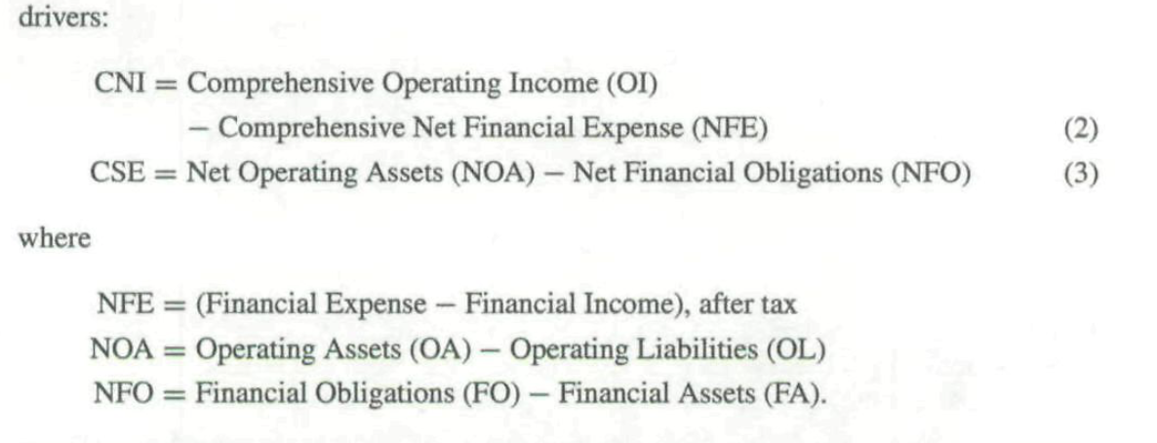
I. Drivers of ROCE
ROCE is the summary profitability ratio in financial statements
Net income (Income Statement items sum)/net asset (Balance Sheet items)
Distinguish between operating items and financing items

Slide 14
Financing & operating continued:
Assets & Liability also need to split out the financing assets and obligation
Breakdowns:
Operating Liability: account payable, wage payable, pension liability and deferred tax liability
Financing Liability: those from raising funds to finance operations
Financing Asset: bond issued/held
Net financing expense/income: interest expense – interest income, preferred interest, realized/unrealized gain or losses on financial A and L, then apply tax deduction
If it is net FA (FA>FO), generate financing income rather than expense

Slide 15
Different forms of ROCE – 1. weighted average of returns
Operating income OI = CNI + NFE

Slide 16
Further simplified version – 2. Clean surplus
FLEV is not the same as D/E in this paper since it is using Net Financing Obligations(financing obligation – financing assets)
ROCE is driven by return on operations with additional return from the leverage of financing activities

Slide 17
Applying DuPont analysis
we break RNOA into Profit Margin and Asset Turnover
It can further be broken down to 5 terms: gross margin ratio, expense/sales ratios, individual operating asset and liability

Slide 18
3. Split other items from sales
Sales margin also include something not generated from sales such as gain and losses on equity investment marked to market, which also included in comprehensive income
After taking off these terms, PM here is only profit generated through sales
Sales PM = OI from Sales/Sales
The first item in this equation is now purely return on operating assets generated by operating activities

Slide 19
4. Split minority interest from income
When the minority interest exists, we need to make further adjustment to CSE
Minority interest is the share of other company’s equity held by the parent corporation
CSE = NOA – NFO – MI
Return on total common equity is: ROTCE = (CNI + MI share of income)/(CSE + MI)
ROCE = ROTCE * MSR
Update both the numerator and denominator

Slide 20
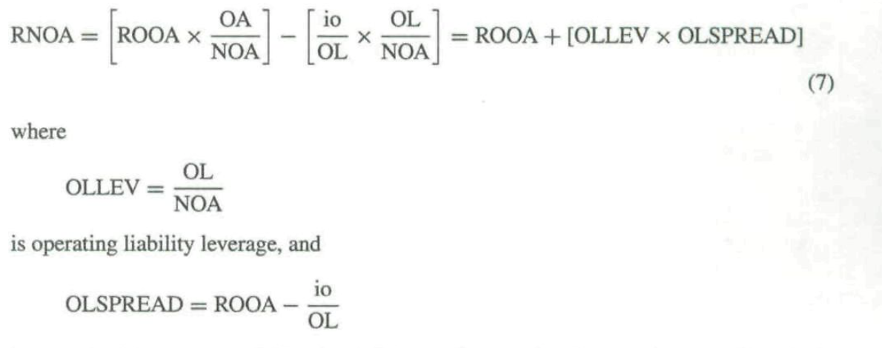
5. Split operating liability
Operating Liability such as wage payables will lever up returns
denominator effects & non-interest credit
IO: implicit interest

Slide 21
5. Continued
RNOA is levered up by operating liability leverage and leverage effect is determined by the operating liability leverage and the spread between ROOA and the implicit borrowing cost(estimated by short term borrowing cost)

Slide 22
My opinion
Not necessary to know all of these ratios, but understanding is important
Many of these equations are just pealed off from the original formula
If there are some aggregate number already, use them to calculate first and use these detailed ratios to backup
Again, separating these items such as splitting unrealized income generated from equity gain etc from operating income involves a lot of understanding of financial statement and each items, which is hard to practice and can easily become problematic

Slide 23
II. Drivers of CSE(book value)
Again, residual income depends on CSE & ROCE
Three drivers here, Sales, asset turnover rate and financial leverage

Slide 24
III. Reducing analysis
Net asset -> operating asset and financing asset
Using similar concept that we value common equity through residual earnings

Slide 25
III. Reduced form continued
For any asset or obligation measured at market value, forecasted residual income must be equal to zero (it is forecasted to earn at the cost of capital)
If NFO is measured on the balance sheet at market value such that NFO = V₀^{NFO}, then the present value of forecasted ReNFE is zero

Slide 26
III. continued
So now the formula only contains net operating assets and the return of it. Plug in to the formula V₀E above, it is simplified so now the drivers of changes only involves drivers of RNOA: sale pm, ATO, other items/NOA, operating liability leverage
Note this method reduces the redundancy, but it only works when financing assets and liability are measured at market value

Slide 27
IV. drivers of growth rate
Since residual income is driven by the accounting rate of return and book value, its growth is driven by increases in the rate of return and/or increases in book value, which is the changes in RNOA and NOA.
Constant RNOA:
Pro forma analysis often comes to the conclusion that, in "the long-run," profitability will converge to a permanent level.
Converge: RNOA = Cost of capital
Growth is driven by NOA changes, NOA increases and thereby creates growth
Constant RNOA, Constant PM and Constant ATO: only sales growths matters
NOA grows at the same rate as sales
Varying RNOA and Constant NOA: growth is generated by the change in RNOA

Slide 28
V. Permanent and transitory terms
Forecasting future depends on current statements, but what we need to figure out is that what indicators/ratios in the statements are likely to persist to the future.

Slide 29
V. Continued
Core functions are likely to become permanent indicators as long as the business functions as usual
Again, it indicates the logic behind these derivations: understanding the nature of financial statements and have a knowledge of what’s changing

Slide 30
Summary & what’s next
The ratio analysis that has been laid out here is a scheme for using ratios in an efficient and orderly manner in valuation analysis.
The analysis is of comprehensive income.
The analysis of current financial statements is guided by the principle of predictive ability.
Ratios further down the hierarchy are utilized only if they provide more information than those higher up.
Profitability analysis is at the heart of the analysis, but this is complemented with an analysis of growth.
Next part is going to be data gathered in the real world scenarios and we will examine the concept we talked above.

Slide 31
Cross-sectional analysis and time-series analysis
Cross-sectional analysis: examine different ratios in a same time frame
Time-series analysis: see how ratios evolve over time
Time-series analysis

Slide 32
Cross-sectional analsis

Slide 33
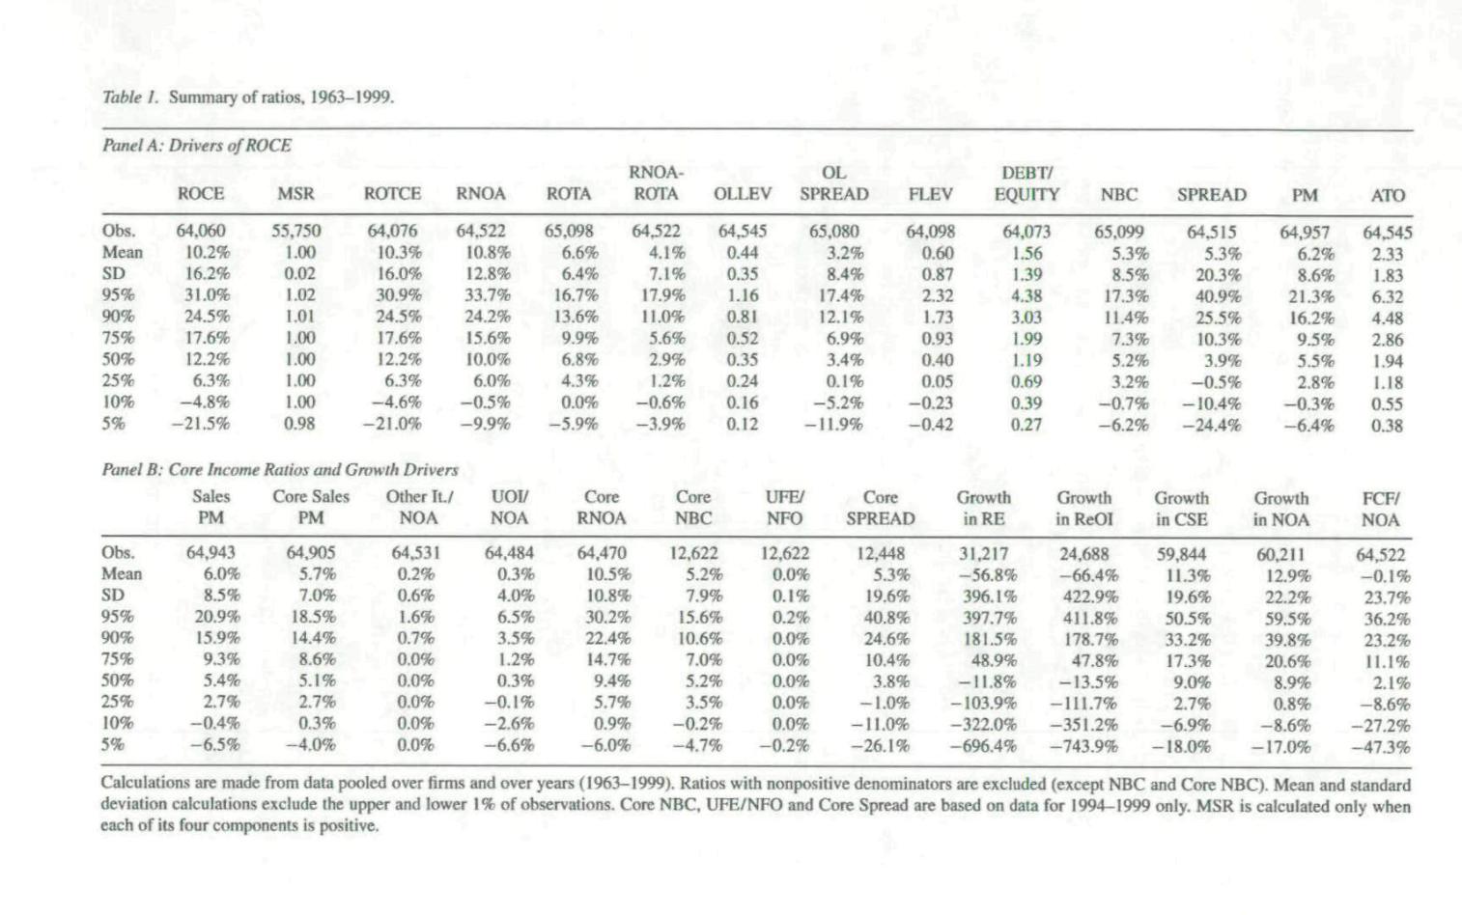

Slide 34
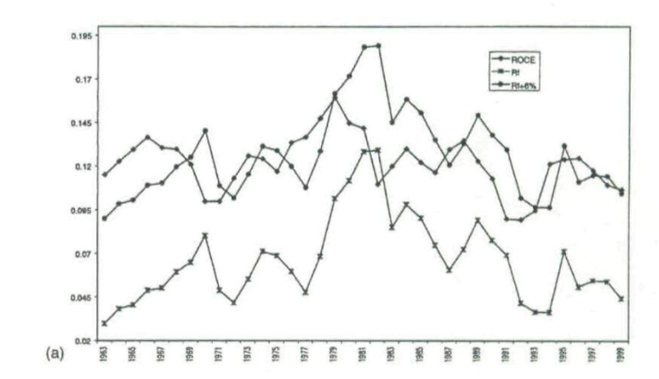

Slide 35
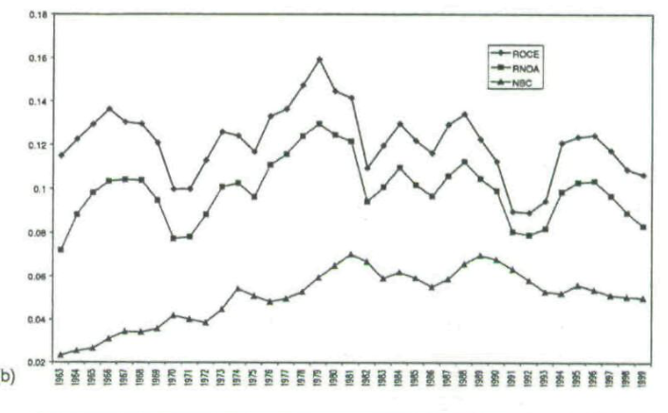

Slide 36
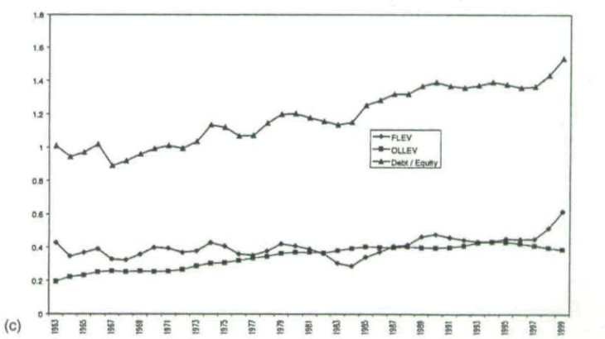

Slide 37
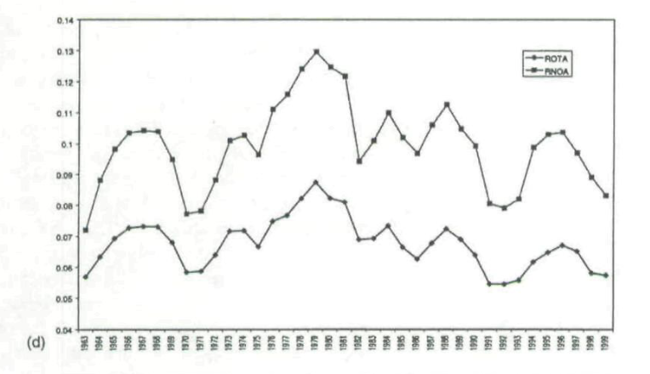

Slide 38
Time-series analysis

Slide 39
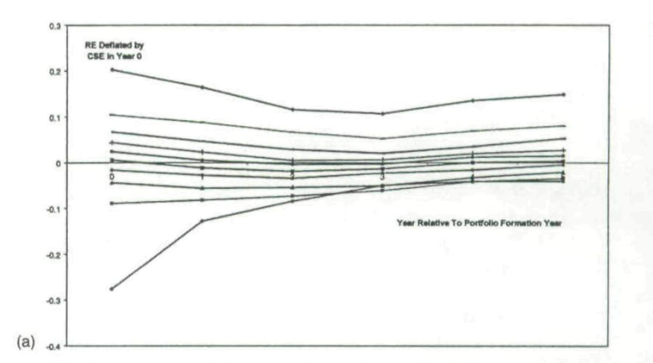

Slide 40
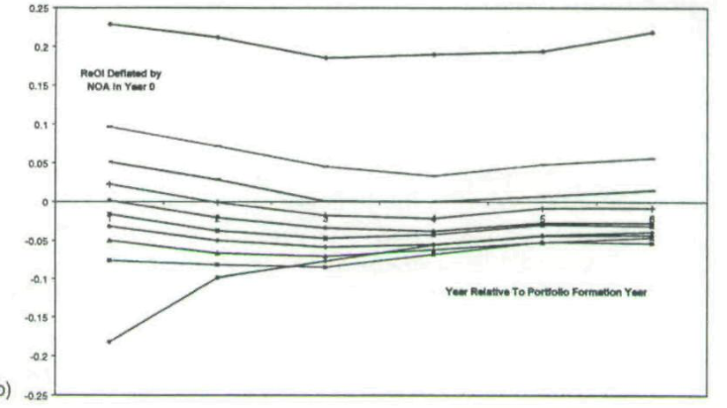

Slide 41
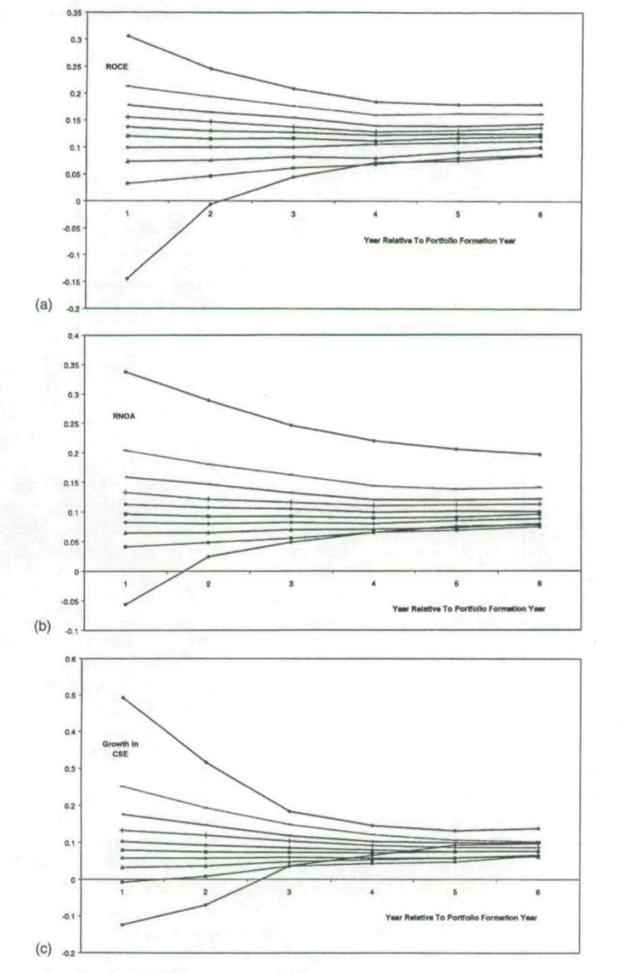

Slide 42
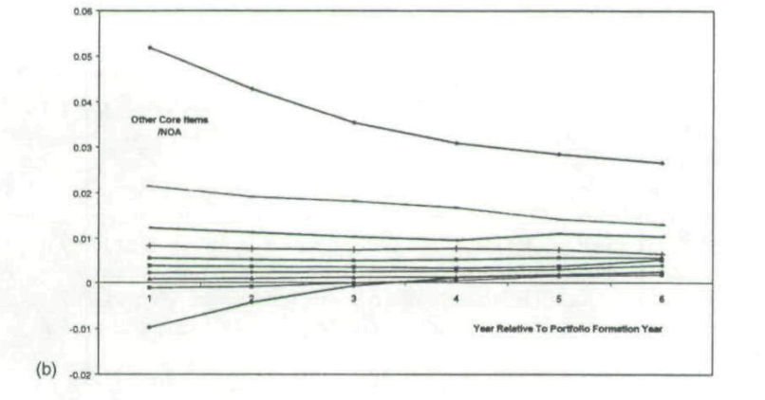

Slide 43
Conclusion
This paper has laid out a structured financial statement analysis that facilitates forecasting and valuation.
The analysis involves an analysis of profitability and an analysis of growth.
The analysis of profitability extends the traditional analysis, the analysis of growth complements it: profitability and growth drive equity values.
The analysis is guided by the residual earnings valuation model but is appropriate for forecasting free cash flows and dividends if other valuation approaches are adopted.

Slide 44
My opinions
Fundamental analysis these days are not as popular as other methods in terms of doing stock selections, but I think understanding accounting and how each items is structured and placed in different statements is fundamental to understand this paper.
This paper is old, published in 2001, but it is classic. We can see many similar concepts and logic in our lectures and some important exams such as CFA.
What really catches me is the logic, how it understands the business, how it split up the financing assets and liability, how it separate the core sales items and unusual items. These all guide us in a sense that in order to assess the financial ability of a company, understanding it’s business structure first and then do calculations.

Slide 45
Thank you

